Slide 1
Using the Nelder-Mead Method to Optimize the Hyper-Parameters of Higher Order Quantum-Inspired Genetic Algorithms
By: Ayush Hariharan

Slide 2
An Ideal Scenario

Slide 3
NP-Complete Problems
Notes:
Protein Folding Problem – Given an amino acid sequence, determine what proteins folded to create that sequence
Boolean Satisfiability Problem – Given a Boolean sequence, determine the values of every variable so that the final value is true
Subset Sum Problem – Given an array, determine a subset that results in a certain sum

Slide 4
The Problem: Complexity

Slide 5
The Solution: Quantum Computing

Slide 6
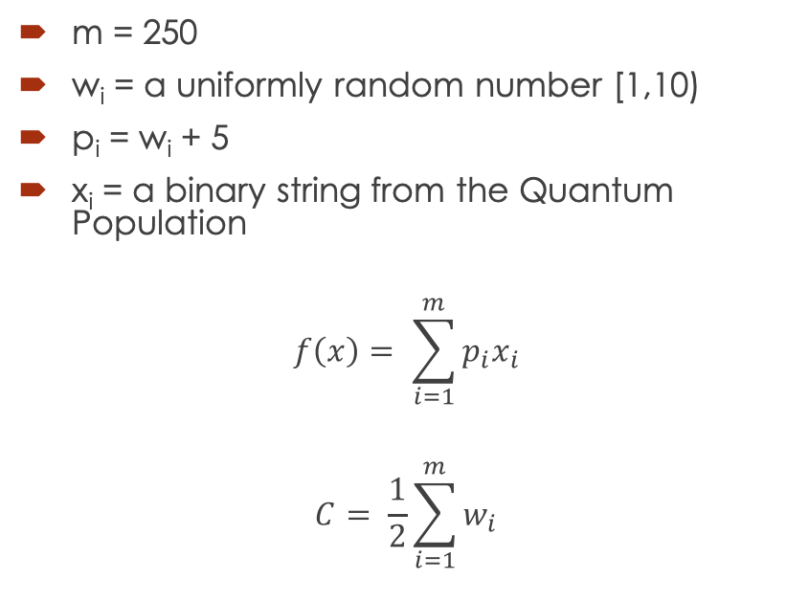
Knapsack Problem
m = 250
w_{i} = a uniformly random number [1,10)
p_{i} = w_{i} + 5
x_{i} = a binary string from the Quantum Population
$$f\left(x\right)= \sum_{i=1}^{m}{p_{i}x_{i}}$$
$$C= \frac{1}{2}\sum_{i=1}^{m}{w_{i}}$$

Slide 7
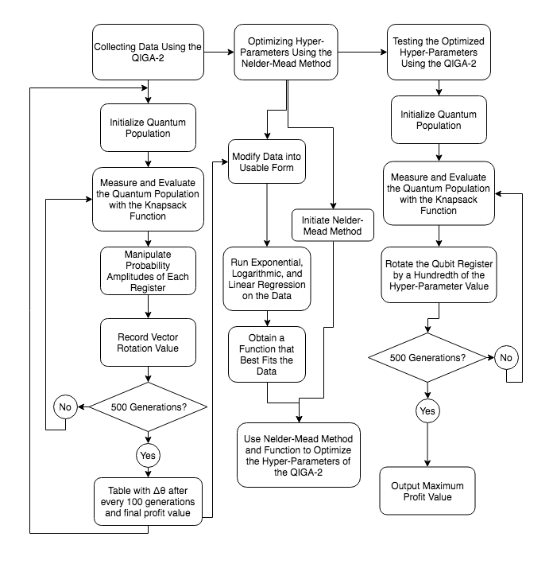
Workflow

Slide 8
Phase 1: Collecting Data Using the QIGA-2

Slide 9
Genetic Algorithms

Slide 10
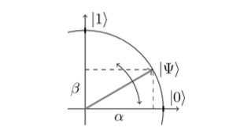
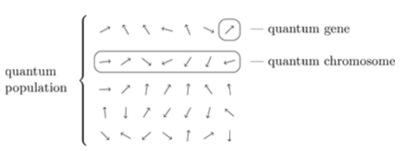
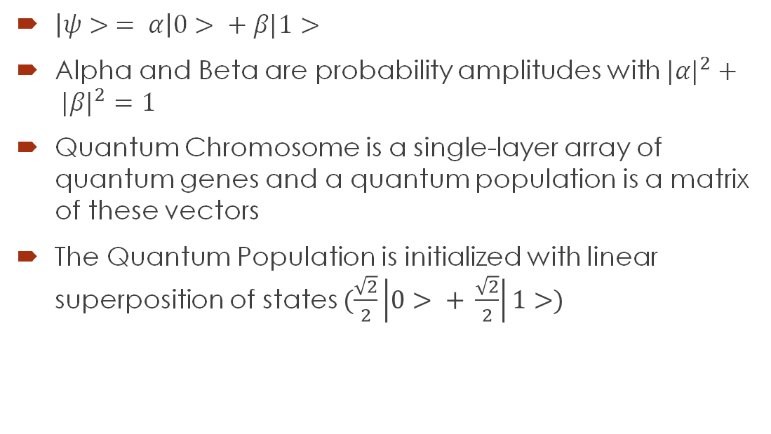
Initialization of Quantum Population
$\left|ψ> = α\right|0> + β|1>$
Alpha and Beta are probability amplitudes with ${|α|}^{2}+ {|β|}^{2}=1$
Quantum Chromosome is a single-layer array of quantum genes and a quantum population is a matrix of these vectors
The Quantum Population is initialized with linear superposition of states $(\frac{\sqrt{2}}{2}\left|0> + \frac{\sqrt{2}}{2}\right|1>)$

Slide 11
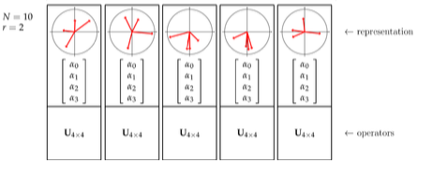
Grouping into Registers

Slide 12
Quantum Measurement (Background)

Slide 13
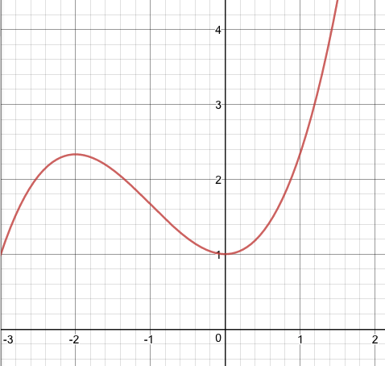
Quantum Measurement (Simplified)

Slide 14
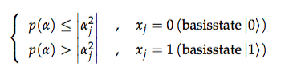
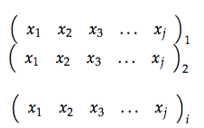
Quantum Measurement (Application)
Qubit observation is then simulated by measuring the values of the quantum population
After measurement, a population, P(t), is obtained composed of classical chromosomes or bit strings.
These strings are then evaluated in the knapsack function to determine which string provides the greatest profit and that string is stored as b.

Slide 15
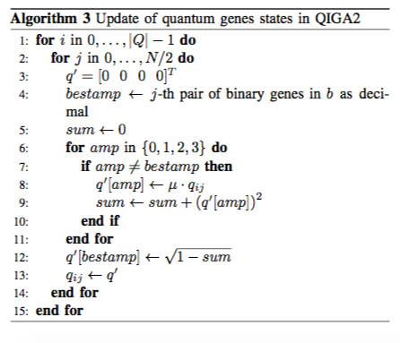
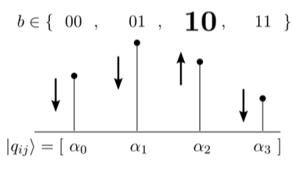
Manipulating Amplitudes
After b is determined for the evolution, the amplitudes of each register are updated.
If the amplitude does not correspond to the j^{th} pair of bits in b, the amplitude is decreased by a factor of µ (approximately 0.99)

Slide 16
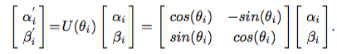
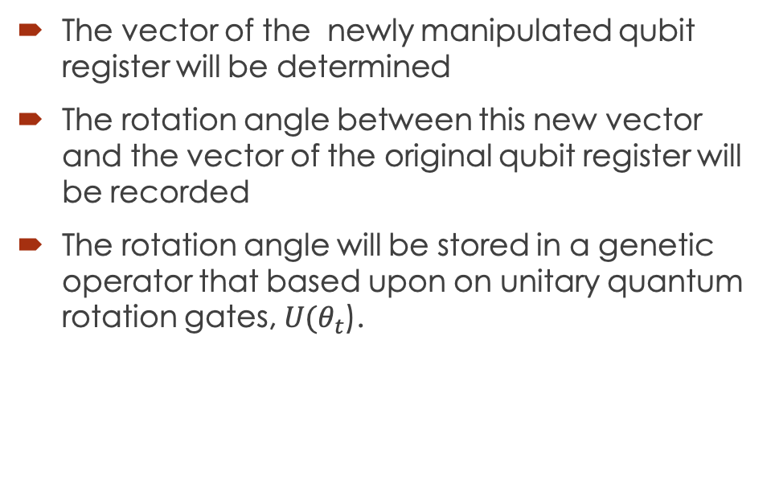
Rotation Values
The vector of the newly manipulated qubit register will be determined
The rotation angle between this new vector and the vector of the original qubit register will be recorded
The rotation angle will be stored in a genetic operator that based upon on unitary quantum rotation gates, $U(θ_{t}$).

Slide 17
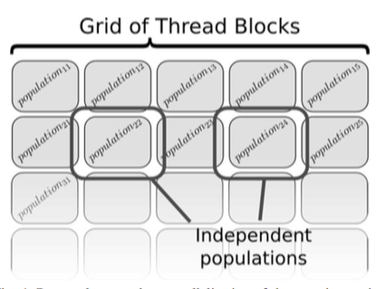
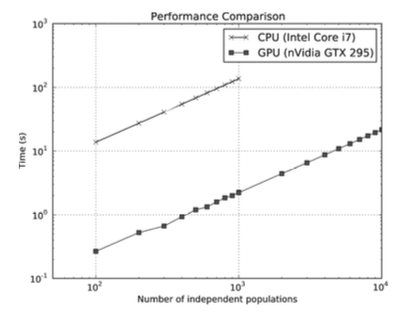
Parallelization

Slide 18
Qiskit IBM vs Traditional Python

Slide 19
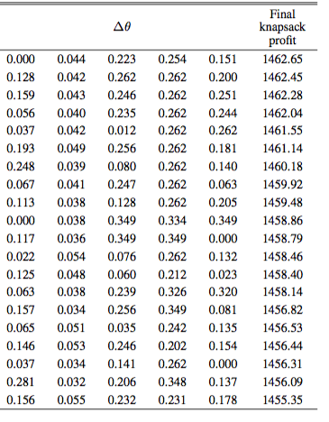
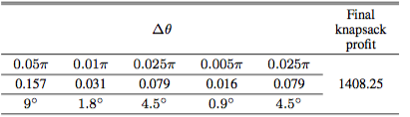
Data

Slide 20
Workflow

Slide 21
Data

Slide 22
WEKA Regression
Linear
Exponential
Logistical

Slide 23
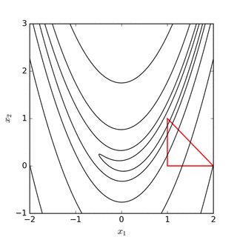
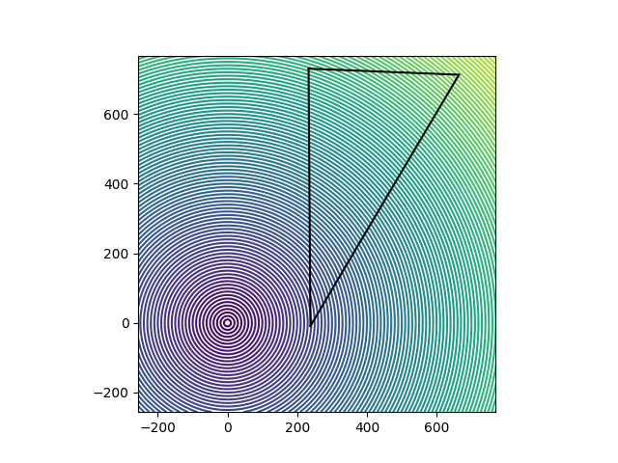
Nelder-Mead Method

Slide 24
Workflow

Slide 25
Testing Optimized Hyper Parameters
Repeat Process in Phase 1
EXCEPT: Instead of manipulating the amplitudes, rotate the vectors by values obtained from the Nelder-Mead

Slide 26
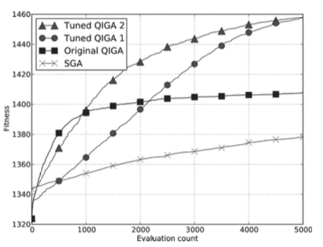
Stabilization Values

